Slide 1
Ami & ebs snapshots
-Velocity Training Institute
-Shantanu Mahajan (sr Engg devops)

Slide 2
What is an AMI?
An Amazon Machine Image (AMI) is a template that contains a software configuration (for example, an operating system, an application server, and applications). From an AMI, you launch an instance, which is a copy of the AMI running as a virtual server in the cloud.
As we know AWS comes with various base images such as rhel, ubuntu, windows, fedora etc, and we can launch these images as per our requirement at runtime using ec2 user data.
But what if we want to create our own image, which is ready to go?
This is nothing but an AMI- an image to use to create our instances

Slide 3
Using a custom image can provide following advantages:-
Pre-installed packages on the instance
Faster boot time
Machines comes configured with enterprise software
Installing your apps ahead of time which helps in faster deployment while auto-scaling
We can use someone else’s AMI that is optimized for running apps, DB etc.
NOTE:- AMI is region specific. i.e. AMI are built for specific AWS region.

Slide 4
Public ami’s
Here we have options to use AMI’s from AWS marketplace as well as community AMIs
In AWS market place we can get licensed and verified copy of the software installed, here aws also verifies these copy hence its quite safe to use these.
In case of community AMI’s, normal ppl like us make the image public for others too use, these are not verified by the AWS and can sometimes have malware and might not be secure. So only use the AMI which you trust.

Slide 5
Ami storage
Your AMI takes space and its is by default stored in Amazon S3.
Amazon S3 is a durable, cheap and resilient storage where most of our backups are kept. (here we wont be able to see them in S3 console but by default they live there)
By default, the AMI’s are private and locked for our account and region.
But we can make them public and share them with other AWS accounts or sell them on AWS MarketPlace.

Slide 6
AMI pricing
AMIs live in Amazon S3, so you get charged for the actual space it takes in Amazon S3.
S3 pricing (US EAST 1).
For free tier 5GB/Month is free
As per below its very inexpensive to store Private AMI.
https://aws.amazon.com/s3/pricing/
First 50 TB / Month | $0.023 per GB
Next 450 TB / Month | $0.022 per GB

Slide 7
EBS Snapshots
These are incremental snapshots which store the data in that particular point of time
These snapshots are also stored in Amazon S3
These snapshot are the exact replica of the EBS volume
With the help of the EBS snapshot, we can copy the volume from one AZ to another and also copy to some other region.

Slide 8
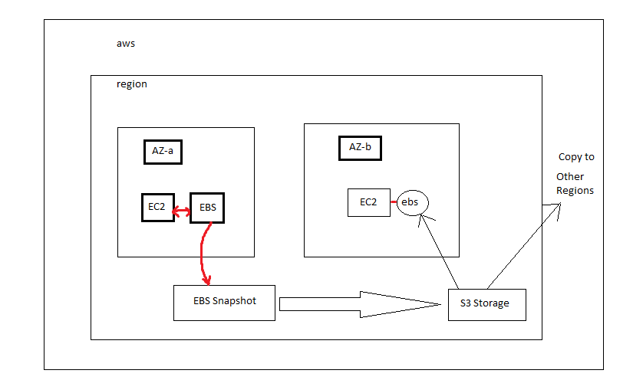

Slide 9
EBS snapshots
Take up less space as stored incrementally
Low cost as its stored in s3 which is cheaper storage in AWS
Full Data recovery guaranteed.
The 1st snapshot will have the written blocks and the next snapshots will have the change blocks, hence we don’t need to have multiple full copies of the snapshots
Deleting the snapshot will only remove the data which is exclusive to the snapshot.

